Slide 1


Building Early Literacy:
The Opportunity and the Challenge
Language Diversity & Literacy Development Research Group
HGSE
Nonie Lesaux, PhD
Early Literacy Summit
Phoenix, AZ
November 8, 2013

Slide 2
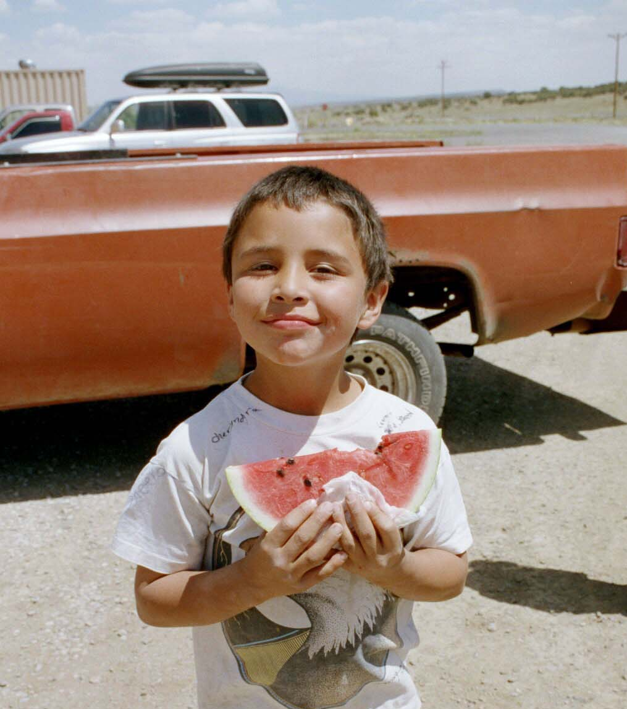
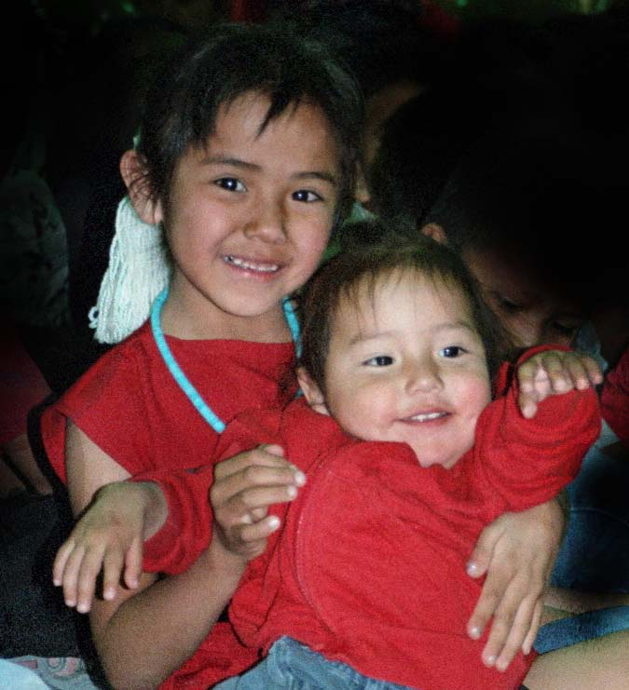
Meet Nathan & Shelby

Slide 3
Today’s Agenda: Three Guiding Questions
How did we come to a comprehensive plan for improving children’s learning outcomes?
What do we know about language and literacy development among diverse populations?
What are the key strategies for increasing the quality of children’s language and learning environments?

Slide 4

Arizona Landscape

Slide 5
AZ’s Children, 0–5
533,333 children ages
0-5
1 of 3 grow up in poverty

Slide 6
Preschool Enrollment
1 out of 4 enrolled in preschool

Slide 7
K-12 Population
1,840 public schools

Slide 8
K-12 Population: Free or Reduced Price Lunch
57.4% of students eligible for FRPL

Slide 9
K-12 Population: Immigrant Status
29% of students from immigrant homes

Slide 10
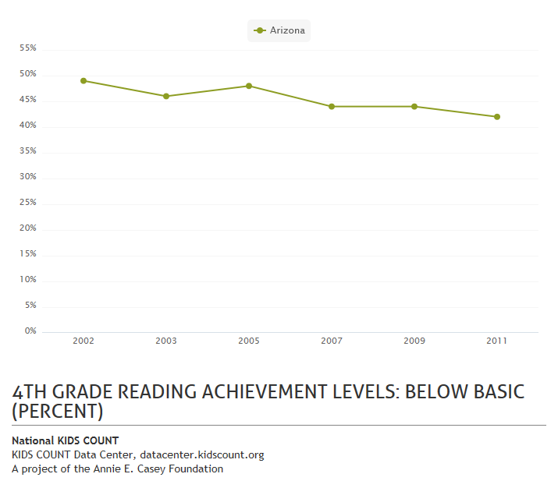

Slide 11
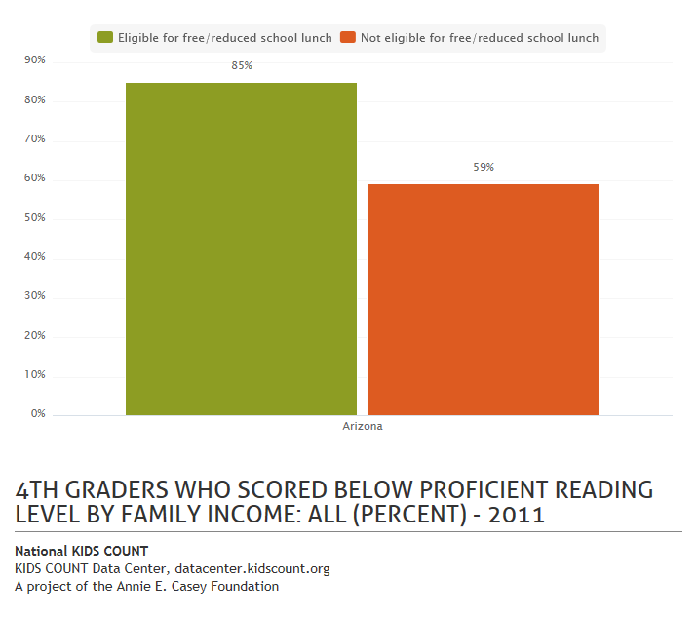

Slide 12
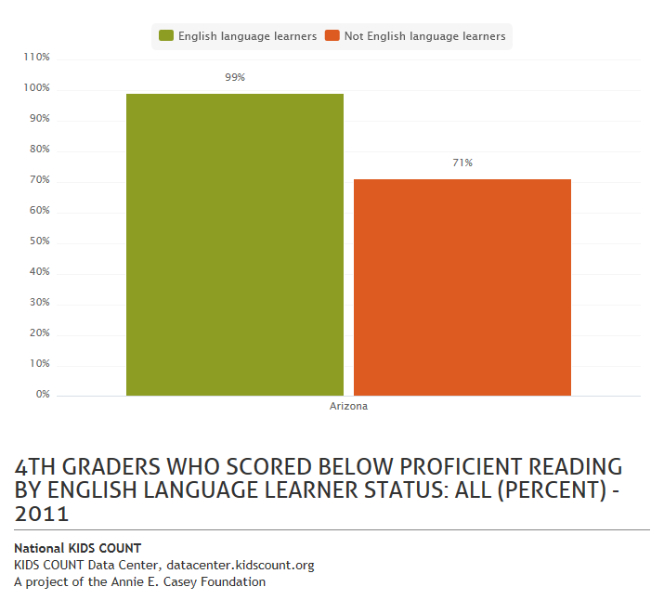

Slide 13
The Demographics of Reading Difficulties
Limited opportunities to develop advanced literacy skills
Linguistic Diversity
Growing up in Poverty
-acute & chronic stressors
-emotional & social challenges
-non-academic language environments
-health & safety issues
Carnegie Corporation of New York, 2009; Murnane & Levy, 1996, 2004; Symonds, Schwartz, & Ferguson, 2011
-enters educational settings
w/ limited primary language
-cognitive advantages
-heightened meta- linguistic awareness
High rates of special education placement
Hehir, 2002; National Research Council, 2002; Samson & Lesaux, 2009
High dropout rates
Under-resourced, segregated schools
Fry, 2010; Bloom & Haskins, 2010; Symonds, Schwartz, & Ferguson, 2011

Slide 14
Guiding Goals
Capitalize on our attributes & resources
Elevate the bar for children at every reading level
Increase individual & societal prosperity
Improving Reading in AZ

Slide 15
Early
LIteracy

Slide 16
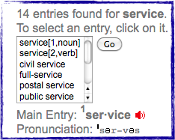
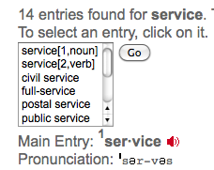
What is Reading?
4 sounds, 1 word:
/s/ /p/ /ee/ /d/
115+ words correct per minute (grade 5)
“-igh family”
high
sigh
thigh
High-Speed Trains
A type of high-speed train was first introduced in Japan about forty years ago. The train is low to the ground, and its nose looks somewhat like the nose of a jet. These trains provided the first passenger service that moved at a speed of one hundred miles per hour. Today, they are even faster, traveling at speeds of almost two hundred miles per hour. There are many reasons that high-speed trains are popular.
/H/
Cognitive strategies
Vocabulary
Interest and motivation
Relevant background knowledge
Understanding of language

Slide 17
Two Different Problem Spaces
Skills-Based Competencies
Knowledge-based Competencies
High-Speed Trains
A type of high-speed train was first introduced in Japan about forty years ago. The train is low to the ground, and its nose looks somewhat like the nose of a jet. These trains provided the first passenger service that moved at a speed of one hundred miles per hour. Today, they are even faster, traveling at speeds of almost two hundred miles per hour. There are many reasons that high-speed trains are popular.
Vocabulary
/H/
“-igh family”
high
sigh
thigh
Cognitive strategies
Relevant background knowledge
4 sounds, 1 word:
/s/ /p/ /ee/ /d/
Understanding of language
115+ words correct per minute (grade 5)
Interest and motivation

Slide 18
Skills-Based vs. Knowledge-Based
Literacy Competencies: A Pervasive Gap
National Rate of Growth_Word Reading: 135 W-score Points
Sample Rate of Growth: 145 W-score Points
National Rate of Growth_Vocabulary: 45 W-score Points
Sample Rate of Growth: 60 W-score Points
Word Reading
Percentile Rank
National Average
Word Knowledge
Age 4.5 Age 8 Age 14 Age 14
Mancilla-Martinez & Lesaux, 2011

Slide 19
Skills-Based vs. Knowledge-Based
Literacy Competencies: A Pervasive Gap
Average
Word Reading Accuracy
Word Reading Automaticity
Passage Reading Fluency
Reading Comprehension
Vocabulary
(Lesaux & Kieffer, 2010)

Slide 20
Two Different Problem Spaces
Literacy: Reading Writing, Listening & Speaking
SKILLS
‐ Concepts about print
‐ The ability to hear & work with spoken sounds
‐ Alphabet knowledge
‐ Word reading & spelling
‐ Fluency
KNOWLEDGE
- Concepts about the world
‐ The ability to understand & express complex ideas
‐ Vocabulary
‐ Oral language skills

Slide 21
What does this mean for our learners?

Slide 22
Lesson #1: The Key Link Between Reading & Language Development
Has 3000-5000 words
Has 250-350 words
Now learning 3,000 words/year
Infant
Toddler
Preschooler
Early Elementary
2nd Grade
Imitates Speech
Vocalize feelings
(cry, giggle)
Looks through a book and retells the story
Reads simple books
Asks questions when listening to stories
Reads independently and talks about what he reads

Slide 23
Lesson #2: Thinking Past “Proficiency”
Oral & Written Language
Complex Ideas

Slide 24
Lesson #3: It Takes Strong, Supportive Interactions Across Contexts
Homes and Families
Early Education and Care
Settings and Schools
Supporting Children’s
Reading Development
Rich conversations
Varied experiences
Personal stories
Songs and rhymes
Word play
Reading & writing together
Excitement around books & learning
Communities
(e.g., clinics, libraries, churches, museums)

Slide 25
Key Strategies

Slide 26
A Framework for Comprehensive Reform
Promoting young children’s language and reading
Program
Design & Implementation for Impact
Ongoing Assessment of Children & Settings
Re-Defined Adult Capacity-Building Models
Language-Rich, Rigorous, and Engaging Curricula
Partnerships with families focused on language & learning
Turning the Page: Refocusing Massachusetts for Reading Success

Slide 27
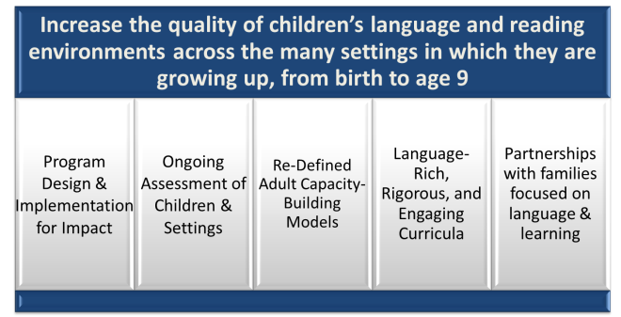
Ensure programs are delivered with sufficient intensity, duration, and scope (before scaling up)
Implementation: Are we really delivering the program or support?
Timing: Are we preventing difficulties and raising literacy rates?
Key Ingredients: What’s working?
Dosage: Are we doing enough to change behaviors?

Slide 28
Conduct early, ongoing assessments of children’s language and reading, and the quality of settings and services
Comprehensive: Measurement across literacy domains
Setting-level: Measure quality and impact

Slide 29
Increase adults’ capacity to assess and support children’s language and literacy development
Foster instructional leadership
Ensure site-level, data-driven, continuous improvement
Expand professional education
Supporting Children’s Literacy Development

Slide 30
A Comprehensive Curriculum Supports Quality Instruction
Rigorous
Engaging
Language-rich

Slide 31
Principles of An Integrated Instructional Approach
Provides direct instruction
Makes Learning Social
Uses consistent routines and language
Uses rich texts as a platform
Cultivates Consciousness
Instruction to Support Language, Literacy, and Social-Emotional Development

Slide 32
Expand and strengthen work with families across learning settings and within communities
Link family engagement to children’s language and reading
Strengthen family literacy community library connection
Tap community leaders

Slide 33
Partnerships with Families
1. Build relationships with all families
2. Share literacy progress
3. Encourage families to read, talk, and play
Put Children's Language & Literacy Learning at the Core!

Slide 34
Making it happen

Slide 35
Focusing on the Architecture of the System
Promoting young children’s language and reading
Program
Design & Implementation for Impact
Ongoing Assessment of Children & Settings
Re-Defined Adult Capacity-Building Models
Language-Rich, Rigorous, and Engaging Curricula
Partnerships with families focused on language & learning

Slide 36
Making It Happen
Raising Awareness
Changing Behaviors
Intensity
- Time
- Money
- Human Capital

Slide 37
Focusing Efforts:
3 Broad Types of Initiatives
Short-term Impact
Long-term Impact
Type
Example
1. Raising Awareness
Book drive
Warm feelings, more books in the home
No evidence of effects on its own
2. Structural Changes
Retention
Bump in achievement
Fade-out of academic gains; social problems, increased drop-out,
3. Capacity Building
High-Quality PreK experience
Bump in achievement, higher vocabulary
Reduced rates of SpEd, higher achievement

Slide 38
Structural v. Capacity-Building Levers: A Cautionary Tale
School Response
Likely Outcome
Limited effects
Long-term costs
Grade retention
Child experiencing academic or behavior difficulties
School Response
Likely Outcome
Strong effects
Long-term benefits
Provide targeted, timely intervention

Slide 39
Summing Up: A Complex Enterprise Demands a Comprehensive Process
Promoting young children’s language and reading
Program
Design & Implementation for Impact
Ongoing Assessment of Children & Settings
Re-Defined Adult Capacity-Building Models
Language-Rich, Rigorous, and Engaging Curricula
Partnerships with families focused on language & learning
Turning the Page: Refocusing Massachusetts for Reading Success

Slide 40







Acknowledgements
Collaborators and Research Team
Funders and Partners
Stephanie Jones, Kargman Associate Professor, Harvard Graduate School of Education
Jeannette Mancilla-Martinez, University of California, Irvine
Michael Kieffer, New York University
Research Team
  Rebecca Bailey
  Julie Russ Harris
  Robin Kane
  Joan Kelley
  Sky Marietta
  Rebecca Givens Rolland
Early Childhood Centers of Greater Springfield, Inc.
rdgstudy@gse.harvard.edu
http://isites.harvard.edu/lesaux

Slide 41
Thank you!

